Slide 1


Building Generative AI Apps with Azure Cosmos DB
Lessons from building the TomTom Intelligent Vehicle Assistant
Notes:
”Hello fellow developers” – greetings from Amsterdam, the home of TomTom.
I'm Massimiliano Ungheretti, a Staff Data Scientist here and I’ll tell you about our experience developing the TT Intelligent Vehicle Assistant.
This assistant is an AI app we’ve worked on for the past year, and it is powered by various Azure services including Azure Cosmos DB.
So, I hope you'll learn something about building with generative AI.

Slide 2

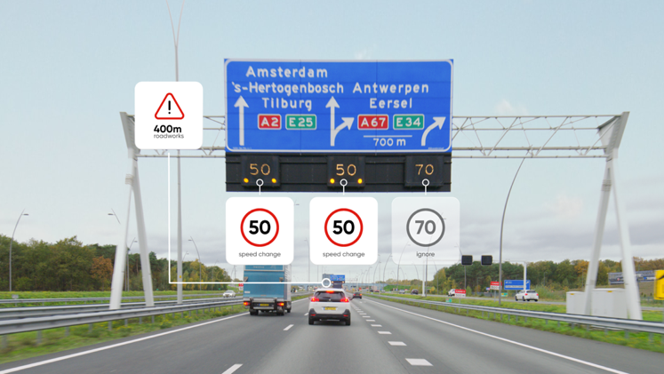
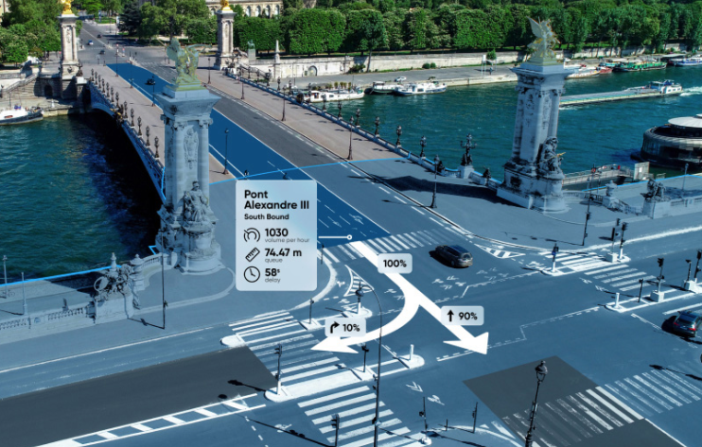
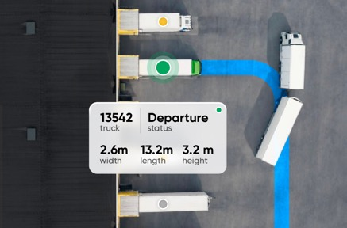
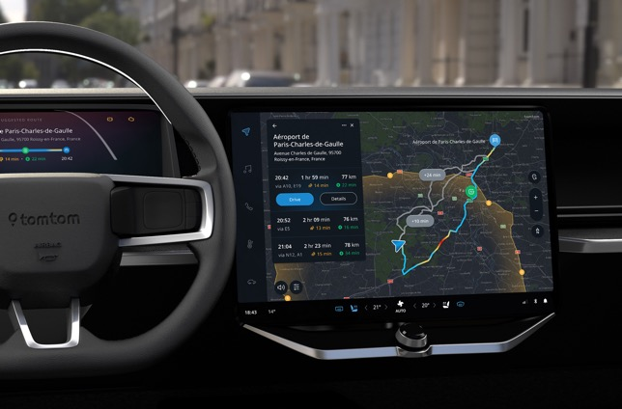

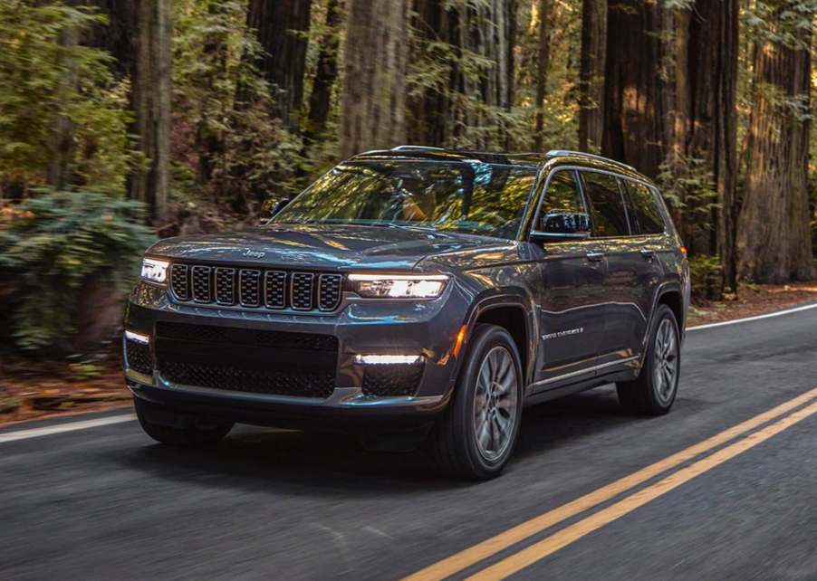
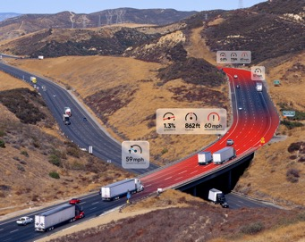
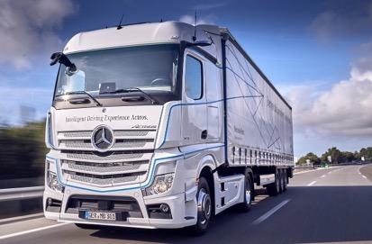
Everywhere location data and mapping services are needed, there is TomTom
`
Notes:
To set the context about this app we built – I'm gonna have to tell you who we are.
Essentially, Everywhere location data and mapping services are needed, there is TomTom.

Slide 3
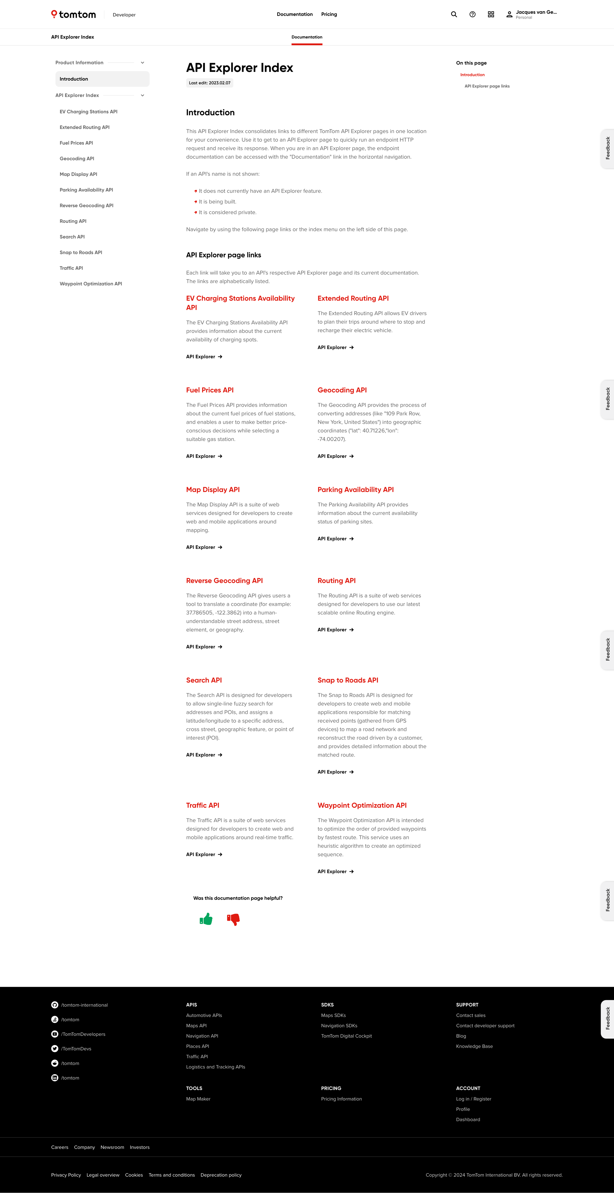
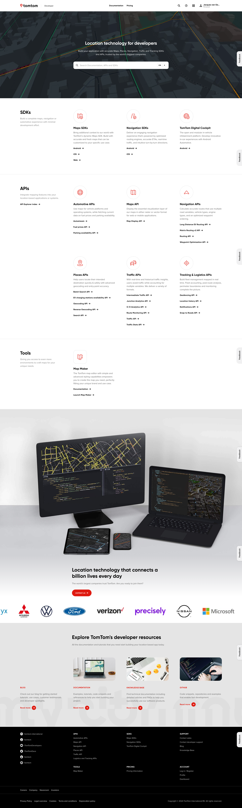

PLACEHOLDER
Here I’d like a slide enticing developers to visit developer.tomtom.com Something like the screenshots below, but of the API’s & SDK page instead of TTDC.
developer.tomtom.com
Notes:
For you developers that means we’re a place to find API’s and SDK’s for location tech.
CLICK
Think showing maps, geocoding address data, creating routes and many other API’s you can check out on our developer portal.

Slide 4
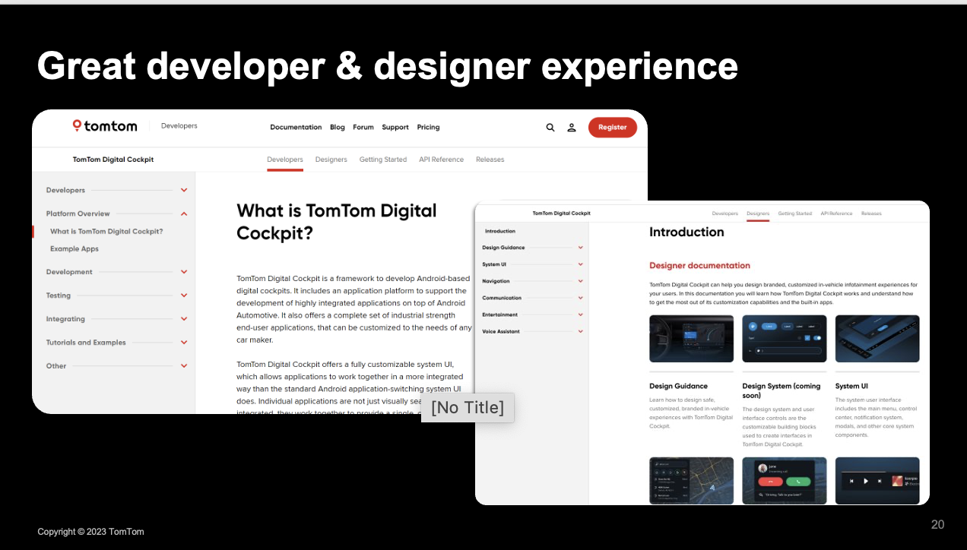
PLACEHOLDER
Here I’d like a slide enticing developers to visit developer.tomtom.com Something like the screenshots below, but of the API’s & SDK page instead of TTDC.
developer.tomtom.com
Notes:
For you developers that means we’re a place to find API’s and SDK’s for location tech.
CLICK
Think showing maps, geocoding address data, creating routes and many building blocks you can check out on our developer portal.

Slide 5
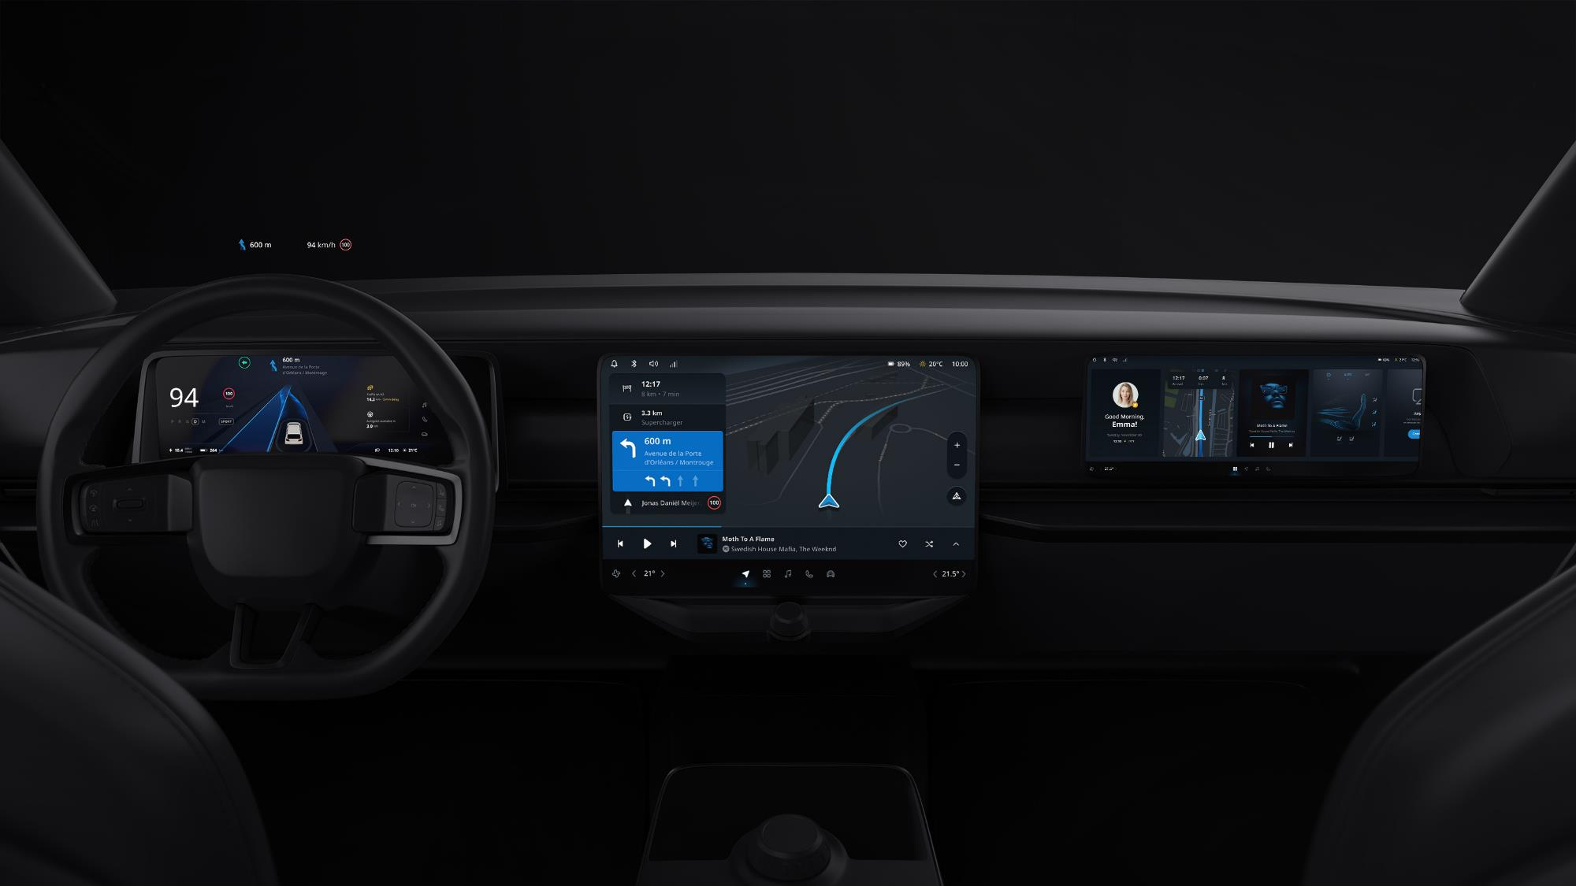
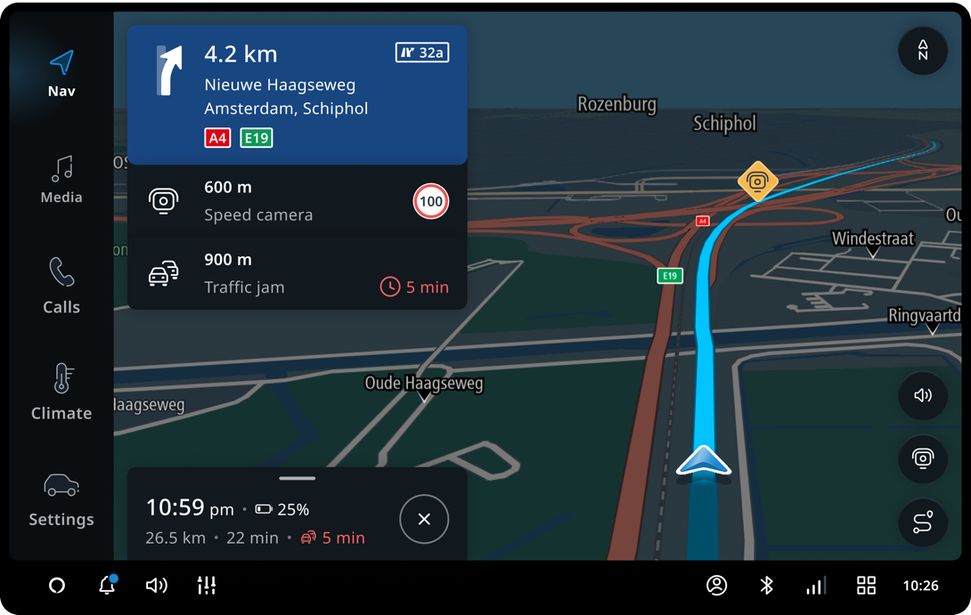
TomTom’s open and modular cockpit HMI development platform that you can build upon
TOMTOM DIGITAL COCKPIT
Notes:
Let’s get down to business – what’s this AI app that we worked on?
Modern connected cars need a digital cockpit that includes lots of location related services.
We offer a platform to allow car makers to develop such cockpits.
When we saw conversational AI’s such as ChatGPT come onto the scene, it triggered us –
NEXT

Slide 6
What could conversational AI mean in a car?
Drivers struggle with complex in-car technology.
Even basic tasks still cumbersome.
Hands-free controls.
Notes:
“What could conversational AI mean in a car?”
We already had experience in the company integrating with various voice assistant technologies.
So we knew a thing or two about the current generation of voice assistant for cars.
First of all, Drivers are still have trouble understanding and using complicated car technology. Think of the complex menu’s you might have to navigate.
Even basic tasks, like finding open restaurants or changing car settings, can become hard. You might recognize the feeling of not being understood by a voice assistant. You have give pretty explicit commands, not quite conversational.
In principle, voice interactions should be safer than touch. However, drivers can find it hard to stay focused on the road when they’re not understood.
Turns out – Generative AI is game-changing enabler for building more conversational assistants. This really comes down to *how you build assistants and how well they understand your intent*.
But I’d like you to see that for yourself, so let’s cut to a demo. POINT TO SIDE

Slide 7
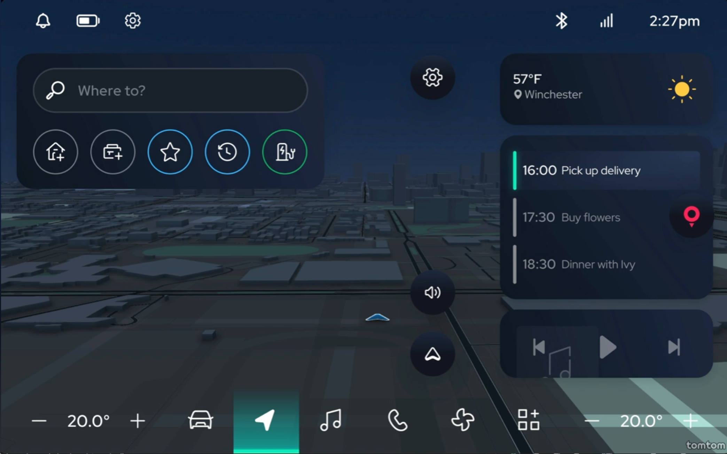

Slide 8
How’d we … …get there?
Notes:
I hope that video helps you to recognize that AI, in this case, is much more than hype - it’s actually enabling new experiences.
So to get to the meat of the matter – How’d we get there?
and
What goes into building with AI?

Slide 9





Ingredients for a conversation with your car
Ears: Automatic Speech Recognition (ASR)
Mouth: Text-to-speech (TTS)
Hands: ”Functions” / “Plugins” / “Actions”
Short term memory: Conversation state
Knowledge: Semantic/Vector search & RAG
Brain: GPT (LLM)
Notes:
We’re clearly going to need at least one LLM for a brain – after all, us being impressed by ChatGPT was the motivating ingredient.
A brain in a vat is only so useful, so we’re going to need more ingredients – CLICK
I need to be able to talk to it – ears & mouth
To roll down windows or plan a route, we’re going to give the brain some hands to take action. Functions are the core concept here. This is how you do many integrations. Related terms to watch out for are “plugins” and “actions”.
A conversation wouldn’t be quite a conversation if there’s no memory – talking with a goldfish is no fun - so we need to manage conversation state in some memory a clear need for a database.
Lastly, the brain as a reasoning engine also needs access to knowledge. We decided to go for dynamic knowledge (RAG) over fine-tuning on a fixed dataset.
Let’s bring in some off-the-shelf Azure components SWIPE & CLICK

Slide 10





Ingredients for a conversation with your car
Ears: Automatic Speech Recognition (ASR)
Mouth: Text-to-speech (TTS)
Hands: ”Functions” / “Plugins” / “Actions”
Short term memory: Conversation state
Knowledge: Semantic/Vector search & RAG
Brain: GPT (LLM)
Notes:
We go with off-the-shelf Azure components so that we’re off to a great start and can put our efforts to work on the CORE concept and iterate towards a product.
Brain – Azure OpenAI and other instruction-tuned models are a great starting point.
Ears & mouth – Just rest assured, Azure has a speech product covering both of these needs.
Hands – This + wiring everything together to the brain is where the rubber meets the road. You will do the work and differentiate.
Short term memory – Azure Cosmos DB – because adopting a NoSQL db here can help – if you want to experiment with the formats.
Knowledge – Azure Cosmos DB and Azure AI Search are THE ingredients to build a ”semantic knowledgebase” for your AI because they offer vector search capabilities.
These are quite some moving parts, we didn’t add them all at once. Because when it comes to doing a “proof of concept”, focus on the core concepts first.
In our case, CLICK
I consider the core technical concept the setup of how LLM’s can be used to integrate TomTom services to enable in-vehicle conversations. It’s essential to validate this first. How you ask?

Slide 11


Iterate – Iterate – Iterate
v0.1: 🦜️🔗 LangChain
💻 “Works on my machine!”
Basic navigation skills
v0.2: Memory & Knowledge
☁️ Shareable cloud app
💪 Infra as Code – Bicep
Memory – Azure Cosmos DB
Knowledge – Vectors & RAG (e.g. car manual)
🆕 Shortcut
v1.0: Integrate!
🔗 Integrate
💯 Evaluation
⛏️ Ditch LangChain
⏪ Manage memory
…
v0.0: ReAct prompt
🛝 Azure OpenAI playground
🌅 ”That worked once”
Notes:
We ITERATE ITERATE ITERATE
Starting with version 0, if you can call it that. I bet that every AI powered product was born either in a chat window or an AI playground.
Azure OpenAI playground is one such way – it’s brilliant for testing our an idea. For us this was initially a paper introducing the “ReAct” prompting technique.
The outcome? A partial validation of the idea – you get it to work at least once.
CLICK
The NEXT iteration was tying a brain to some TomTom hands! Given this was early 2023, LangChain 0.0.something had come out a few weeks prior and provided a nice starting point.
Awesome! We now have a brain connected with our core skills. But it only works on my machine, and we want more feedback from colleagues and testers –
CLICK let’s bring it to the cloud and let it the app grow up a bit. We want a shareable link. Using an example repo from the Azure website instantly gave us infra as code. You also can’t quite get away with in-memory conversation history so we add Azure Cosmos DB to manage that. Now sprinkle on some vector search magic and you can search through your car’s manual.
CLICK In fact, there are now many shortcuts you can take, including going from a prompt in the playground to a deployed app with Cosmos-based memory.
CLICK Time to get prod-ready because real value is only in reach when you can reach users. Often that’ll mean integrating into some existing product. This is also a great time to work on your quality assurance process – how will you evaluate somewhat random answers?
”As always frameworks will get you off the ground *fast* - but be willing to abandon them when it’s sensible, which we did.” You can imagine that this list goes on.
To reiterate, what was the point of these steps?
Smallest way to test an idea
Using a framework to test it in a demo app
Making it shareable for feedback – Cloud deployment templates can help the app grow up quickly.
To deliver value, this needs to be integrated into an actual product (new or existing). This last step will be an endless iteration, because expectations will rise over time.

Slide 12





Architecture
In-Vehicle
Cloud
Digital Cockpit
Speech SDK
Azure Speech Services
Plugins
Azure Cosmos DB
Azure Open AI
Azure
AI Search
Retrieve status
Execute commands
Plugins
Location Services
Bing
Vehicle Access
Azure Container Apps /
Azure Kubernetes Services
Notes:
Here’s what we ended up with on a high level – some integrations in the vehicle, and a large part in the cloud with all of the yummy ingredients I described before.
But what I’d like for you to take away:
“We put together a lot of Azure bricks as starting points, so that most of the creative & innovative efforts going to the brain and how to integrate it with TomTom’s location services.“

Slide 13
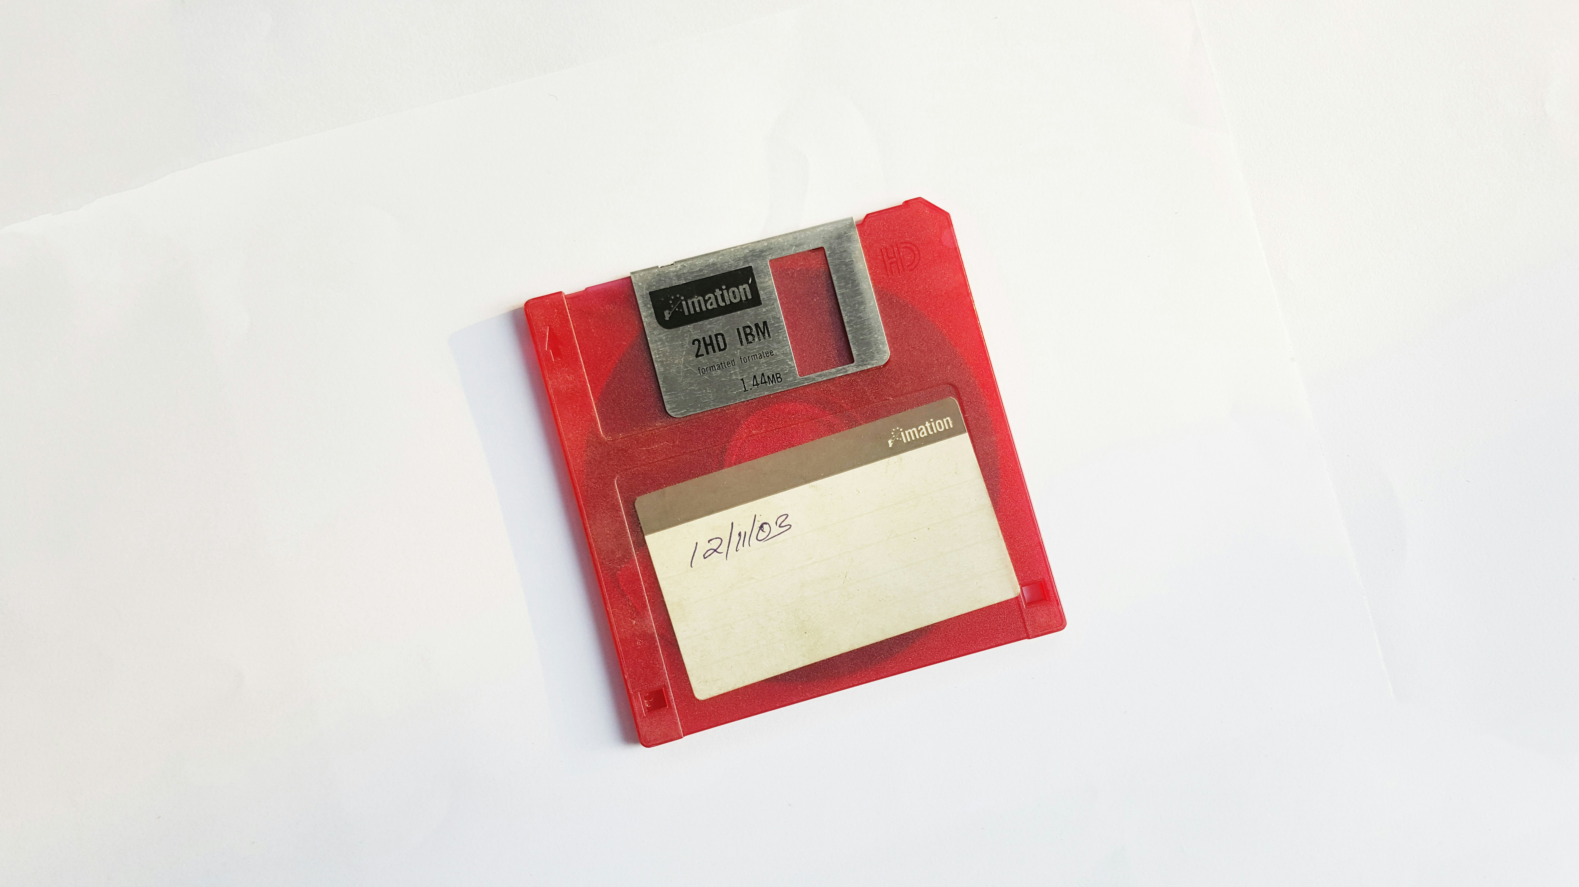

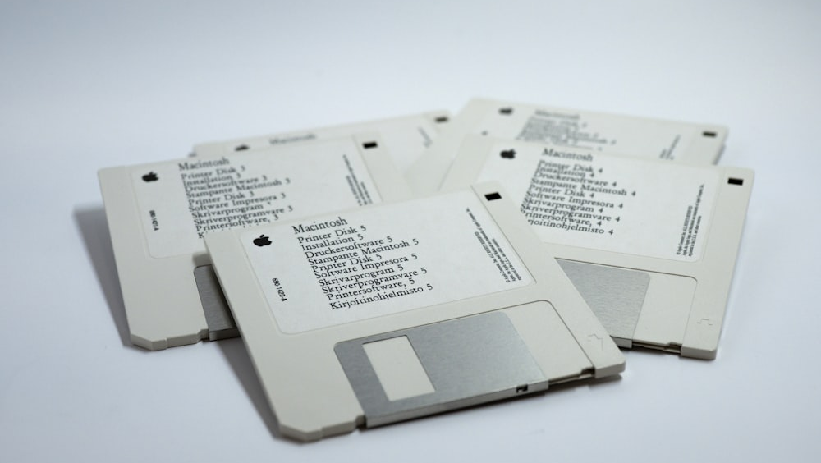
Memory & Knowledge
Notes:
What type of choices will you have to make when developing an AI app with Cosmos DB?
Memory
Memory: As a conversation length grows, AI slows down. Make tradeoffs - You can be fast and forgetful or slow and never forgetting.
Tips: Using TTL for short term memory, trimming and many clever tricks around.
Knowledge
Bust myth “For an AI to use my data, it needs to train on it.” – instead, you can search your knowledge inject context instead. AKA RAG
How do you ingest knowledge – this is one of the hardest parts.
Azure CosmosDB - … https://learn.microsoft.com/en-us/azure/cosmos-db/vector-database
How to get started?
There’s a number of guides and templates available online and if you’re using a framework like LangChain, promptflow or semantic kernel, I bet you have a ready-made integration as a starting point.

Slide 14
Take-aways
GenAI → 🆕 dev paradigm
Prototype & Iterate
Cloud services to accelerate
AI memory is hard
Notes:
Personally Exciting AI —>
New patterns – programming with language, RAG, guardrailing, unstructured -> structured
Testing – output is “random text”, non-deterministic
To keep up with all of this – when building with AI –it’ll be even more important to prototype and iterate.
Small prototypes on your laptop are great for demo’s, but adopting cloud services as the next step helps to accelerate.
Finally, “AI memory and knowledge management” is hard and an evolving field. I expect a lot of developments here this year. Just know that Cosmos can help with AI memory and knowledge management.
Hope you learned something, bye WAVE

